Slide 1
Legal Disclosure
The information presented in these training materials is based on guidelines and practices accepted within the mortgage finance industry generally and is not intended to be all-inclusive. All examples are hypothetical and are for illustrative purposes only. Investor requirements change from time to time and their application is subject to interpretation. Therefore, we cannot and do not guarantee how any specific investor guidelines will be applied to individual circumstances. Our training is not intended and should not be interpreted or relied upon as legal advice. We encourage you to seek legal and compliance advice from a qualified professional.
MGIC expressly disclaims any and all warranties, express or implied, including without limitation warranties or merchantability and fitness for a particular purpose regarding these materials and our training program. In no event will MGIC be liable for any direct, indirect, incidental, punitive or consequential damages of any kind with respect to the training or materials provided.

Slide 2
For Sale to Sold
A Mortgage Handbook for Real Estate Agents

Slide 3
Today’s Presentation
Chapter 1: The Mortgage Cycle
Chapter 2: Originating the Loan
Chapter 3: Processing the Loan
Chapter 4: Underwriting
Chapter 5: Understanding Private Mortgage Insurance

Slide 4

Chapter One
The Mortgage Cycle
The Stages of the Mortgage Cycle
Regulatory Compliance
Key Players and Their Roles

Slide 5

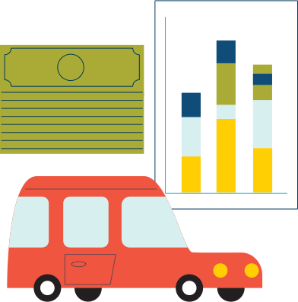







The Mortgage Cycle
Preapproval
Origination
Processing
Loan Servicing
Underwriting
Secondary Market
Delivery
Warehousing
Closing

Slide 6
Regulatory Compliance
The Dodd-Frank Act
  Consumer Financial Protection Bureau (CFPB)
  Qualified Mortgages (QMs)
  TILA-RESPA Integrated Disclosures (TRID)

Slide 7
Regulatory Compliance
Consumer Financial Protection Bureau
  Educates and protects consumers
  Regulates lending practices
  Enforces consumer protection laws

Slide 8
Regulatory Compliance
TRID
  Loan Estimate (LE)
  Closing Disclosure (CD)

Slide 9
Key Players in the Mortgage Cycle
Intermediaries
Investors
Other specialized players

Slide 10

Chapter Two
Originating the Loan
Loan Options
The Loan Application

Slide 11
Loan Types
Conventional loans
    Conforming
    Nonconforming
Government loans

Slide 12
Loan Programs
15- and 30-year fixed-rate mortgages
Balloons
Temporary buydowns
Adjustable-rate mortgages (ARMs)

Slide 13
Loan Program Considerations
How important is payment certainty?
How important is rapid equity buildup?
Do the homebuyers anticipate increasing income?

Slide 14
The Loan Application
The framework for your homebuyers’ mortgage
Guides an informed loan decision
Officially called the Uniform Residential Application (URLA)
Quality information is crucial

Slide 15
Questions that Encourage
Quality Information
How do you pay your rent – cash, check, money order, online?
    Do you have access to copies of the cancelled checks or money orders?
Are you aware of any credit problems you may have?
    If so, when did they occur?
Do you have any student loans?
    If yes, are they current or in deferment?

Slide 16
Questions that Encourage
Quality Information
What funds will you be using for the down payment – checking, savings, stocks, gift of cash?
If divorced, does your divorce decree indicate any monthly obligations?

Slide 17
Tips for the Fastest Trip to the Closing Table
Preapproval
Preferred method of communication
Be accessible and responsive
Step up your role as the industry expert

Slide 18
Section 1: Borrower Information
1a. Personal Information
1b. Current Employment/Self-Employment and Income
1c. Additional Employment/Self-Employment and Income
1d. Previous Employment/Self-Employment and Income
1e. Income from Other Sources

Slide 19
Section 1: Borrower Information
1a. Personal Information

Slide 20
Section 1: Borrower Information
1b. Current Employment/Self- Employment and Income
1c. IF APPLICABLE, Complete information for Additional Employment /Self-Employment and Income

Slide 21
Section 1: Borrower Information
1d. IF APPLICABLE, Complete Information for Previous Employment/Self-Employment and Income
1e. Income from Other Sources

Slide 22
Section 2: Financial Information – Assets and Liabilities
2a. Assets – Bank Accounts, Retirement and Other Accounts You Have
2b. Other Assets and Credits You Have

Slide 23
Section 2: Financial Information – Assets and Liabilities
2c. Liabilities – Credit Cards, Other Debts, and Leases that You Owe
2d. Other Liabilities and Expenses

Slide 24
Section 3: Financial Information – Real Estate
3a. Property You Own
3b-3c. IF APPLICABLE, Complete Information for Additional Property

Slide 25
Section 4:
Loan and Property Information
4a. Loan and Property Information
4b. Other New Mortgage Loans on the Property You Are Buying or Refinancing
4c. Rental Income on the Property You Want to Purchase
4d. Gifts or Grants You Have Been Given or Will Receive for this Loan

Slide 26
Section 5: Declarations
5a. About this Property and Your Money for this Loan
5b. About your Finances

Slide 27
Section 6: Acknowledgments and Agreements

Slide 28
Section 7: Military Service
Section 8: Demographic Information

Slide 29
Section 9: Loan Originator Information

Slide 30
Lender Loan Information
L1. Property and Loan Information
L2. Title Information
L3. Mortgage Loan Information

Slide 31
PITIA
Principal
Interest
Taxes
Insurance
All other

Slide 32
Lender Loan Information
L4. Qualifying the Borrower – Minimum Required Funds or Cash Back

Slide 33

Chapter Three
Processing the Loan
Processing Responsibilities
Why all the Documentation?
Efficiencies of Automated Underwriting
Preparing the Loan for Underwriting

Slide 34
Processing Responsibilities
Ensuring data integrity
Keeping the lines of communication open
Gathering and verifying documentation
Preparing and submitting a thorough, accurate loan file
Satisfying underwriting conditions
Preparing the loan for closing

Slide 35
Why All the Documentation?
Documentation validates:
  Property value
  Source of down payment
  Employment history
  Income, assets and liabilities
  Present and proposed housing expense

Slide 36
Loan Documentation
How much documentation is required?
How is documentation procured?
  Standard verification
  Electronic verification
  Third-party verification

Slide 37
Efficiencies of Automated Underwriting
Fannie Mae’s - Desktop Underwriter (DU)
Freddie Mac’s - Loan Product Advisor
  Evaluates risk
  Reduces documentation and processing time

Slide 38
Preparing the Loan for Underwriting
Qualifying ratios
Loan-to-value ratios

Slide 39
Qualifying Ratios
Housing Ratio
Debt-to-Income (DTI) Ratio

Slide 40
Housing Ratio
Example
Total Primary Housing Expense (PITIA) |  |  |  | $1,470.55
Total income |  |  |  | $9,159.00
 | $1,470.55 |  | = Housing Ratio
 | $9,159.00
 | 16.056% |  | = Housing Ratio

Slide 41
Debt-to-Income (DTI) Ratio
Example
Total All Monthly Payments |  |  | $2,455.55
Total Income |  |  | $9,159.00
 | $2,455.55 |  | = Total Debt Ratio
 | $9,159.00
 | 26.81% |  | = Total Debt Ratio

Slide 42
Loan-to-Value (LTV) Ratios
LTV Ratio
CLTV/TLTV Ratio

Slide 43
LTV Ratio
Example
Sales Price |  |  | $200,000
Appraised Value |  |  | $201,000
Mortgage Amount |  |  | $180,000
 | $180,000 |  | = LTV Ratio
 | $200,000
 | 90% |  | = LTV Ratio

Slide 44
CLTV/TLTV Ratio
Example
Sales Price |  |  | $200,000
Appraised Value |  |  | $201,000
First Mortgage Amount |  |  | $180,000
Second Mortgage Amount |  |  | $10,000
 | $180,000 + $10,000 |  | = CLTV/TLTV Ratio
 | $200,000
 | $190,000 |  | = CLTV/TLTV Ratio
 | $200,000
 | 95% |  | = CLTV/TLTV Ratio

Slide 45


Chapter Four
Underwriting
Measure The 4 Cs:
  Credit
  Capacity
  Capital
  Collateral

Slide 46
Credit: Measuring Willingness to Repay
Credit History
Have your homebuyers:
Demonstrated a consistent willingness to pay obligations as agreed?
Proven their ability to manage their finances over time and under various circumstances?

Slide 47
Credit: Measuring Willingness to Repay
Credit Documentation
Traditional
Nontraditional

Slide 48
Credit: Measuring Willingness to Repay
The Credit Report
Reflects homebuyers’ regard for credit
National credit repositories
Credit scores

Slide 49
Capacity: Assessing the Ability to Repay
Evaluating Income
Employment history
Documenting income
Calculating income from employment

Slide 50
Capacity: Assessing the Ability to Repay
Gross Monthly Income
Base employment income
Overtime income
Bonuses
Commissions
Dividends/interest
Net rental income

Slide 51
Capital: Evaluating the Commitment to Repay
Examining the homebuyers’ assets
Strong saving patterns
Down payment amount relative to sales price
Capital to cover down payment and closing costs
Adequate savings or other reserves

Slide 52
Capital: Evaluating the Commitment to Repay
Documenting Assets
Sufficient cash assets to close
Cash management skills

Slide 53
10 Things Homebuyers Should
Avoid Before Closing Their Mortgage
DO NOT:
Buy a big-ticket item
Quit or switch jobs
Open or close any lines of credit
Make large deposits to accounts outside their paychecks
Let someone run a credit check on them
Pay bills late
Ignore questions from their lender or real estate agent
Cosign a loan with anyone
Take out any payday loans
Change bank accounts

Slide 54
Collateral:
Confirming the Property’s Value and Marketability
The Appraisal
Is the property thoroughly described, including explanations of any unusual situations?
Is value consistent with the description of the property?
Is value supported by the sales price of similar properties?

Slide 55
5 Things Your Homebuyers
Should Know About Appraisals
AU determines the level of review and type of appraisal
Certain property features’ value varies market to market
The appraisal doesn’t verify the sales price, but confirms whether market data supports it
The appraisal is based on market data, which appraisers must support with recent sales and listings
A low appraisal can be a negotiating tool

Slide 56
Collateral:
Confirming the Property’s Value and Marketability
The Sales Contract
Information matches loan application
Signed by all involved parties
Includes all referenced addenda
Contingencies
Chattel property included in sales price
Sales concessions
Lender/investor guidelines are satisfied

Slide 57

Chapter Five
Understanding Private Mortgage Insurance
How MI Works
How MI Benefits You
How MI Benefits Your Homebuyers
The Cost of MI
Common MI Premium Plans

Slide 58

How MI Works
Borrower Down Payment 10% of Property Value
Borrower Down Payment $20,000
MGIC MI Coverage 25% of Loan Amount
MGIC MI Coverage $45,000
$180,000
Loan
$180,000
Loan
Lender Exposure
67.5% of
Property Value
Lender Exposure
$135,000
Expressed in %
Expressed in $
$200,000 Property

Slide 59
MI Gives You an Extra Advantage
Save your homebuyers thousands
of dollars
Broaden your customer base
Increase your commissions
Enhance your role as a Trusted Advisor

Slide 60
How MI Benefits Your Homebuyers
Increased buying power
Expanded cash-flow options
Lower monthly payments
Cancellable

Slide 61
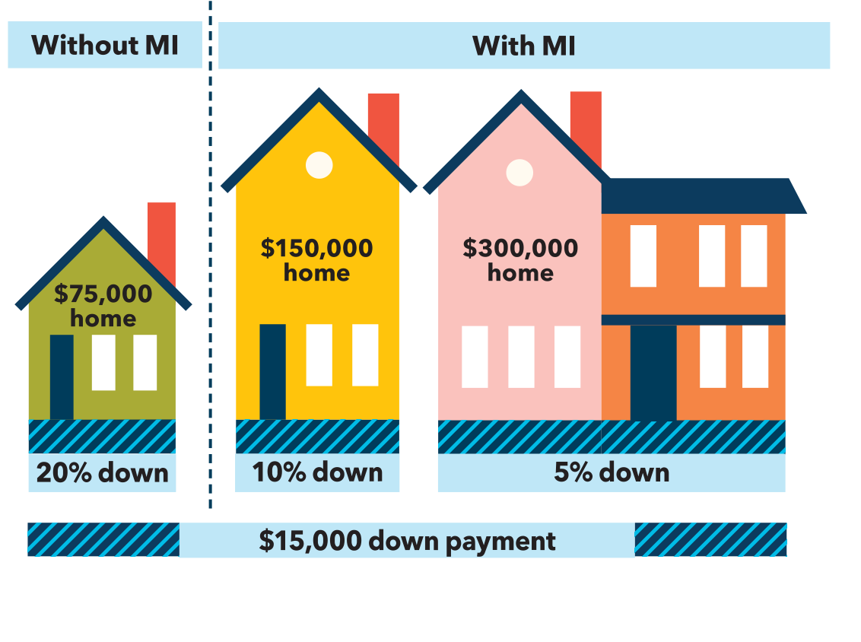
Increased Buying Power

Slide 62
Expanded Cash-Flow Options
Less money down
Use funds for remodeling, redecorating, college funds, retirement, etc.

Slide 63
Lower Monthly Payments
Better credit scores, lower MI premium rates
Mortgage payments less than FHA financing
Saves thousands of dollars over the life of the loan

Slide 64
Cancellable
Homeowners Protection Act
Borrower-requested cancellation
at 80% LTV
Automatic cancellation at 78% LTV

Slide 65
The Cost of MI
Premium plan
Mortgage loan program
Loan term
Whether premium is refundable/nonrefundable
LTV
Amount of MI coverage
Representative or indicator credit score
Loan amount
Loan purpose or occupancy status

Slide 66
Common MI Premium Plans
Borrower-paid monthly premiums
Borrower-paid single premiums
Lender-paid single premiums

Slide 67
Borrower-Paid Monthly Premiums
Simplicity, easy of use
No money due at closing
No up-front cost
Cancellable
Lower monthly payment upon cancelling
Equity builds faster

Slide 68
Borrower-Paid Single Premiums
Lower monthly payment
Flexibility
Cancellable
Refundable

Slide 69
SUMMARY
The Mortgage Cycle
Regulatory Compliance
Originating the Loan
Processing the Loan
Underwriting – Measuring The 4 Cs
Understanding PMI
Resources

Slide 70
Thank you!

